Slide 1
Soil Nutrient Analysis using Principal Component Analysis (PCA)
Reducing multi-nutrient soil data into interpretable patterns
Students: [kaveri _2520090068.], [Navya _252009007.],[Sahasra_2520090067]
Guide / Supervisor: [I V S L Haritha]
Department of [CSIT]
[University]:[KLH]
Academic Year: [2025– 2029]

Slide 2
Introduction
Background
Domain Overview
Why Needed
Soil fertility drives crop yield and food security
Labs report many nutrients per sample: N, P, K, pH, OC, EC, micronutrients
Precision agriculture and soil informatics
PCA is an unsupervised technique that compresses correlated variables into a few components
Nutrient variables are highly correlated and hard to interpret together
Need a simple, data-driven view of soil variability

Slide 3
Problem Statement
Existing Problem
Limitations / Challenges
Who Is Affected
Soil test reports contain 10+ correlated parameters
Hard to see overall fertility patterns by eye
Nutrient-by-nutrient analysis ignores interactions
Redundant, high-dimensional data
Manual interpretation is slow and subjective
Farmers and agronomists
Soil testing labs
Agricultural researchers and policy planners

Slide 4
Motivation
Why This Project
Real-World Need
Research / Industry
Apply a core machine-learning technique to a real agricultural dataset
Make soil data easier to interpret
Fertilizer over-use raises cost and harms the environment
Farmers need quick, clear soil-health insights
PCA is widely used in soil science and chemometrics
Growing demand for data-driven precision farming

Slide 5
Objectives
Main Objective: Use PCA to reduce and interpret soil nutrient data, identifying the key factors that explain soil variability.
Collect and preprocess soil nutrient data
Standardize variables and compute the correlation structure
Apply PCA and select components via explained variance
Interpret loadings to find dominant nutrient groups
Visualize samples with score plots and biplots

Slide 6
Existing System
Current Approach
Technologies
Limitations
Lab testing of individual nutrients
Comparison against fixed threshold ratings (low / medium / high)
Spreadsheets and basic statistics
Soil test kits and lab reports
Univariate charts
No view of relationships between nutrients
Many variables to track at once
Misses hidden patterns across samples

Slide 7
Proposed System
Proposed Solution
How It Addresses Limitations
Python-based PCA pipeline for soil nutrient data
Standardize, decompose, and visualize in one workflow
Outputs components, loadings, and plots
Cuts many variables to a few components
Reveals correlations through loadings
Gives objective, repeatable interpretation
Fast visual summary of all samples

Slide 8
System Architecture / Block Diagram
Input
Processing
Algorithm / Model
Output
Soil sample data (CSV)
N, P, K, pH, OC, EC, micronutrients
Cleaning and imputation
Outlier check
Standardization (z-score)
Covariance matrix
Eigen decomposition (PCA)
Component selection
Explained variance
Loadings and scores
Scree plot and biplot

Slide 9
Methodology / Workflow
1
2
3
4
Collect soil data
Clean and handle missing values
Standardize features
Compute covariance matrix
5
6
7
8
Eigenvalues and eigenvectors
Select components (scree, ≥80% variance)
Project data and interpret loadings
Visualize and report
Row 1 → Row 2: after step 4, the flow continues from the left of the next row.

Slide 10
Technology Stack
Language & Tools
Libraries
Data & Hardware
Python 3
Jupyter Notebook / Google Colab
NumPy, Pandas
scikit-learn (PCA, StandardScaler)
Matplotlib, Seaborn
CSV / Excel dataset files
Optional: SQLite for storage
Standard laptop; no GPU needed

Slide 11
System Modules / Components
Data Layer
Core Processing
Output Layer
Data Collection: load soil test records
Data Preprocessing: clean, impute, scale
PCA Module: fit and transform
Component selection: explained variance
Visualization: scree plot, biplot, heatmap
Reporting: loadings table and insights

Slide 12
Implementation
Load dataset with Pandas
Impute missing values; scale with StandardScaler
Fit PCA from scikit-learn
Read explained_variance_ratio_ and choose k
Plot scores and loadings
from sklearn.preprocessing import StandardScaler
from sklearn.decomposition import PCA
X = StandardScaler().fit_transform(df[features])
pca = PCA(n_components=0.80)
scores = pca.fit_transform(X)
print(pca.explained_variance_ratio_)
loadings = pca.components_.T

Slide 13
Dataset / Input Data
Dataset
Features
Preprocessing
Name: [Dataset name / source]
Records: [N] soil samples
Region: [location]
Macronutrients: N, P, K, S
Chemistry: pH, EC, organic carbon
Micronutrients: Zn, Fe, Cu, Mn, B
Remove duplicates, fix outliers
Impute missing values (median)
Z-score standardization

Slide 14
Algorithm / Model
Algorithm
Why PCA
Key Parameters
Principal Component Analysis (unsupervised)
Eigen decomposition of the correlation matrix
Soil nutrients are correlated
Reduces dimensions while keeping most variance
Components are uncorrelated and interpretable
n_components: variance ≥ 80%
Scaling: StandardScaler
Selection: scree plot and Kaiser (λ > 1)

Slide 15
Results
Key findings
PC1–PC3 explain about 77% of variance
PC1: macronutrient fertility (N, P, K, OC)
PC2: acidity / salinity (pH, EC)
PC3: micronutrients (Zn, Fe, Mn)
PCA is unsupervised, so accuracy, precision, recall and F1 do not apply; variance explained is the metric.
Illustrative values – replace with your dataset results.

Slide 16
Results: Comparison with Existing Methods
Aspect | Existing (univariate) | Proposed (PCA)
Variables | Analysed one at a time | Analysed jointly
Redundancy | Not handled | Removed via components
Patterns | Hidden | Visible in score plots / biplots
Interpretation | Manual, subjective | Loadings-based, objective
Dimensions | 10+ parameters | 2–3 components

Slide 17

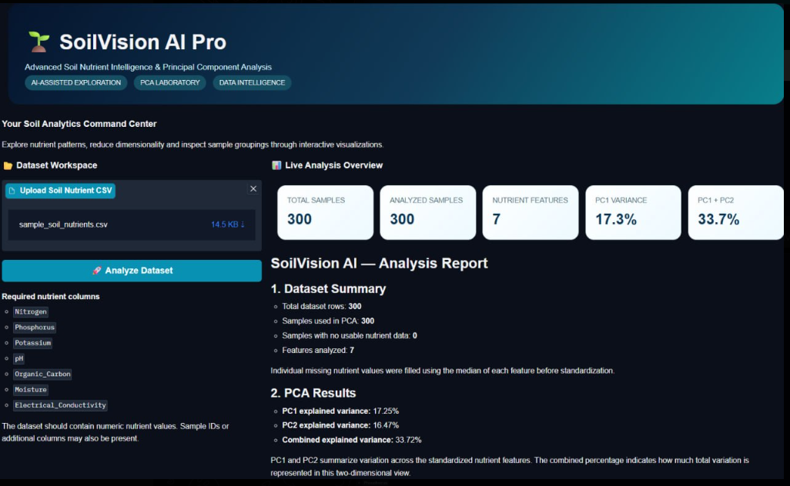

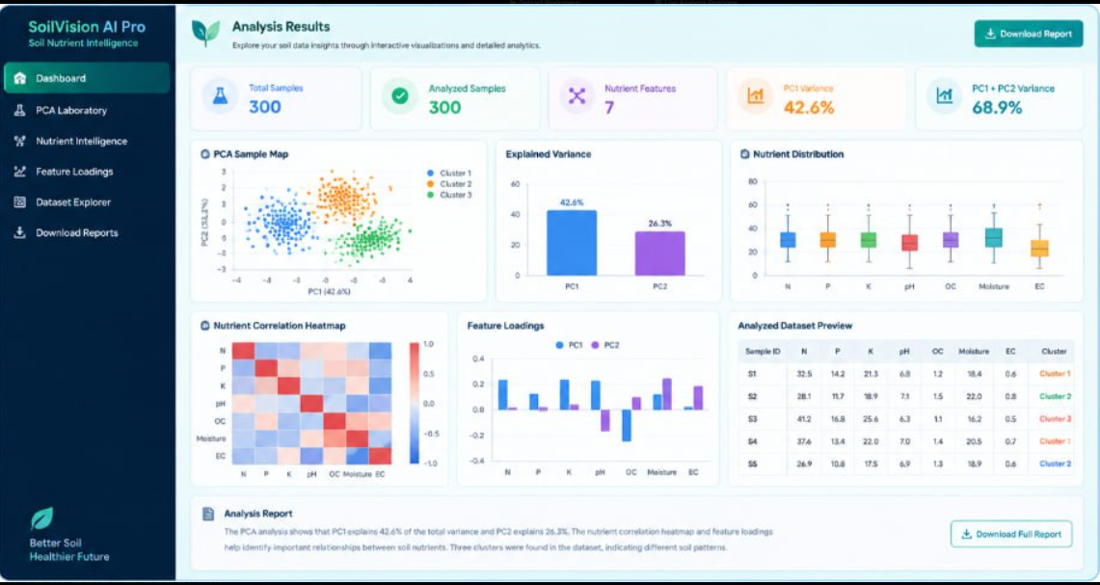
Screenshots / Demo
[Insert screenshot]
Home page
Input screen
[Insert screenshot]
[Insert screenshot]
Processing screen
Output / result screen

Slide 18
Advantages
Benefits
Improvements over Existing
Simplifies complex soil data
Removes multicollinearity
Open-source, low-cost, fast
Multivariate instead of one-nutrient view
Clear visual summary of samples
Repeatable and objective

Slide 19
Applications
Real-World Uses
Target Users / Industries
Soil fertility zoning
Fertilizer recommendation support
Soil health monitoring over time
Farmers and agri-advisors
Soil testing laboratories
Agri-tech companies and researchers

Slide 20
Limitations
Current Limitations
Dataset / Technical Constraints
PCA assumes linear relationships
Components are less intuitive than raw nutrients
Sensitive to outliers and scaling
Limited sample size and region
No yield or crop-response data included
Unsupervised: no direct fertility prediction

Slide 21
Future Scope
Improvements
Additional Features
Deployment & Scaling
Compare with t-SNE, UMAP, kernel PCA
Combine PCA with clustering (K-Means)
Web dashboard for upload and results
Add satellite / weather data
Cloud deployment as a soil-advisory tool
Mobile app for farmers
Multi-region datasets

Slide 22
Conclusion
Achieved
Built a PCA pipeline that compresses soil nutrient data into a few meaningful components.
Key outcome
A small set of components explains most variability and highlights the dominant nutrient groups.
Contribution
A simple, reproducible, data-driven approach to support better soil management decisions.
Thank you | Questions?

